Slide 1
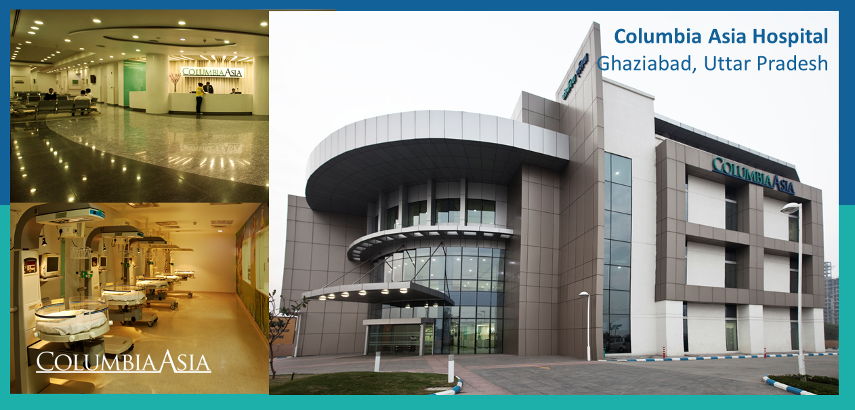

Slide 2

Introduction
Columbia Asia is an international private healthcare company with an extensive network of hospitals. The Columbia Asia Hospital started its operations in the year 1996. Currently it has 22 medical facilities across Southeast Asia: 14 in Malaysia, 3 in Vietnam and 5 in Indonesia.
Columbia Asia medical facilities provide a wide array of medical services such as General Surgery, Pediatrics, Obstetrics & Gynecology, Orthopedics and Internal Medicine. These are supported by a comprehensive list of ancillary services that include an Intensive Care Unit, Neonatal Care Unit, Physiotherapy, Laboratory, Pharmacy and Imaging.
The company believes in setting up mid-size hospitals built in residential areas for accessibility and efficiency, and to better serve the respective communities.
Columbia Asia aims to be the preferred choice of healthcare services for families and businesses.

Slide 3

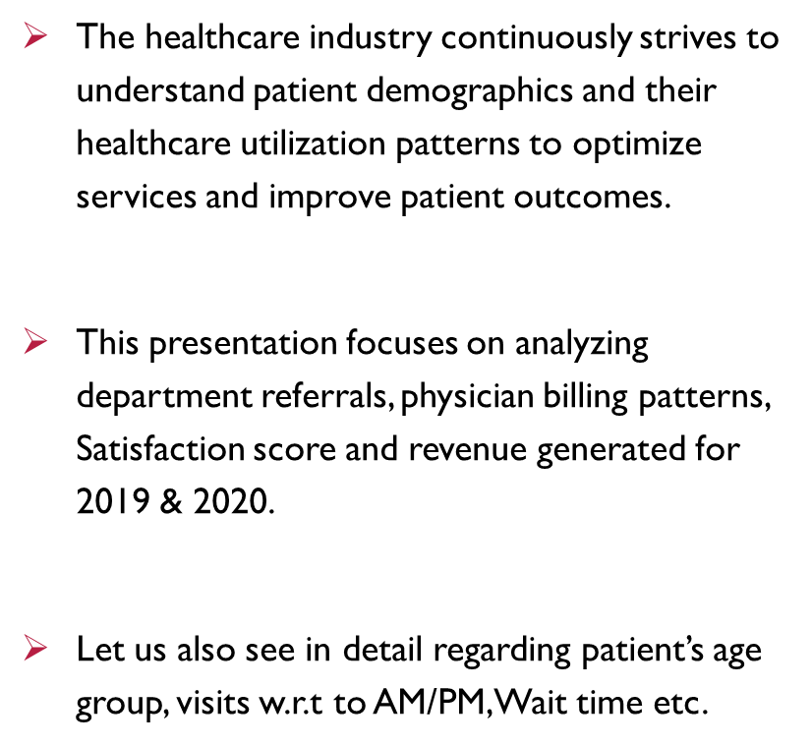


Slide 4

Brief Overview of Columbia Asia Hospital system
Total number of Patients across the Hospital : 9216
Total Revenue generated throughout the month: $509.31 Million
Number of Doctors available: 22
Number of available Departments: 7
Average Satisfaction score given by the Patients: 5.47 for the services
Highest visited department: General Practice.
By this report, we will understand the procedure and practices of Columbia Asia Hospital, their services, their profits, gender/race basis analysis and much more.

Slide 5

Data Cleaning: Utilized functions using Power Query Editor to check column status, health, Null values etc.
Data Enrichment: Enhanced the dataset with additional variables using different DAX functions to cross reference external data sources.
Descriptive Analysis: Employed New measures for summarizing key metrics and identifying distribution patterns across different departments and Patient category.
Visualization: Created dynamic charts and Reports for data representation, enabling interactive data exploration.
Analytical Approach

Slide 6
KPIS

Slide 7
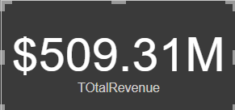
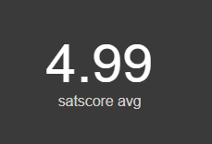
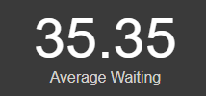
Analysis
The total revenue earned by the hospital is about $509.31M.
The average satisfaction score of the patient is around 4.99.
The average waiting_time of the patient is around 35.35 mins

Slide 8
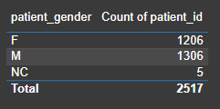

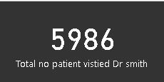
Analysis
There are 1306 male and 1206 female patient in hospital.
The Max wait time of patient.
Total no of patient visited to Dr. Smith.

Slide 9
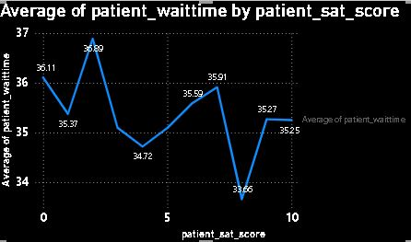
Analysis
We can say that the average patient wait time is inversely proportional to satisfaction score, in many cases its seen that the less average time wait has high satisfaction score as compared to the patient whose wait time is higher. It can be seen that low wait time has a score of 8-10 while high wait time has score rate of 0-3.

Slide 10
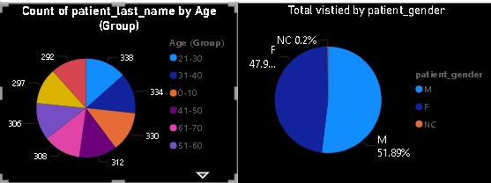
Analysis
From the given data set it can be that the majority of the patient coming to the hospital are male that is around 1306 while only 1206 females visit the hospital. On the basis of the ages of patients the maximum number of patients that visits the hospital belongs to the age group of 20 (20-30).

Slide 11
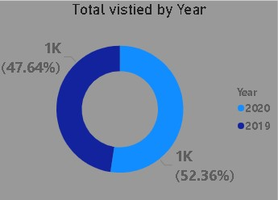
Analysis
The blue slice, labeled “2020” is larger and accounts for 47.64% of the total visitors. The green slice, labeled “2019” is smaller and accounts for 52.36% of the total visitors.

Slide 12
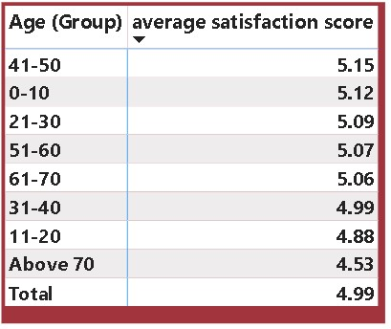
Analysis
The age group of (40-50) shows the highest satisfaction score i.e. 5.15 While the age group of (Above 70) shows the lowest satisfaction score i.e. 4.53. (used average satisfaction score vs. age group)

Slide 13
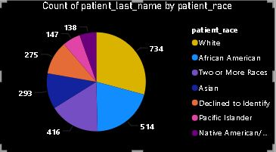
Analysis
So, if someone outside of the hospital claims that there is racial or gender-based discrimination in the hospital, it can be said that the above claim was not true as it can be that second majority of the patient in the hospital visited are African American, not only that but more than 5 racial community comes here for the treatment. Not only by racial but along with that the female patients are in good number which is only 100 less than that of male patients. So the hospital is non-biased in terms of race and gender of patients

Slide 14
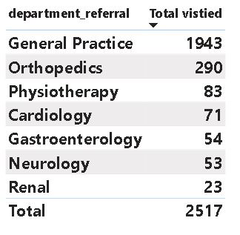
Analysis
If the hospital has a budget to hire 2-3 new doctors, they should be hired in the Orthopaedics, General Practice and Physiotherapy, as they have highest numbers of visitors and a smaller number of doctors. Thus, it will help in increasing the revenue as these departments are busier as compared to others

Slide 15
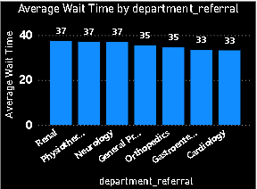
Analysis
The average waiting time of the renal department is oddly large as compared to other departments which is around 37.43 minutes. Which is followed by Physiotherapy department which is 37.04 minutes. While the cardiology has the least waiting time that is 33.25 minutes

Slide 16
Conclusion
If as compared to the appointment fees taken by the doctors to the total revenue earned by hospital, it can be said that the hospital is profitable. As the total fees by the doctor is 5.35M. thus by excluding that from the total revenue determines the profitability.
There is a one-to-many relationship between the doctor id and department, as each doctor is assigned to single department. Like one doctor is associated to single department. But there a department have multiple doctors
The hospital management should offer discounts to the patients of the age group of 60 (60-70) & (above 70). As they are seniors and need more assistance as compared to the youth generations, thus it will help in increasing the satisfaction score of patients and there can be increase in the patients of this age group also.
The strategies we could use to provide discounts to the patients should be like giving 50% discount in the appointment fees of doctor to all the seniors category of 60 (60-70) & Above 70 And we can also provide extra free facilities to the senior citizens like massage area or free regular tests. Thus, it will not increase the number of patients but also increase the satisfaction score of patients by attracting new patients.

Slide 17
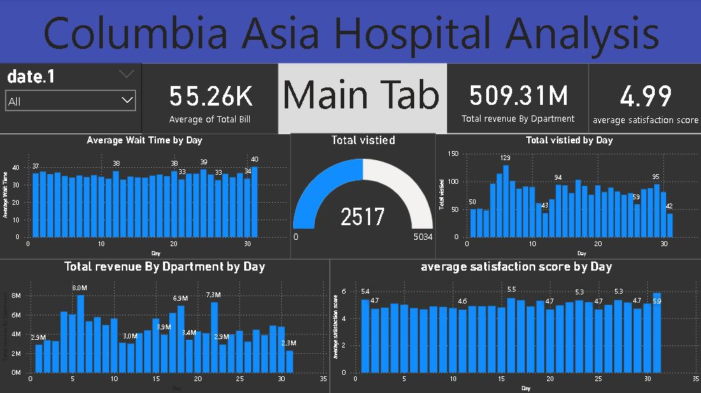
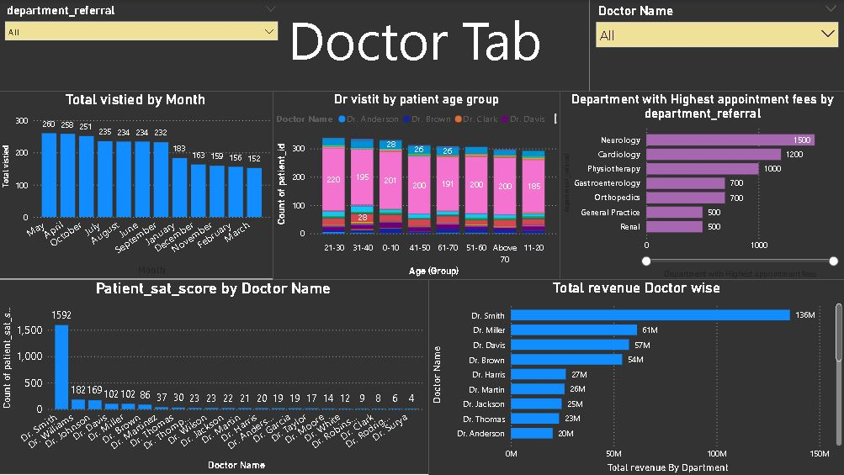
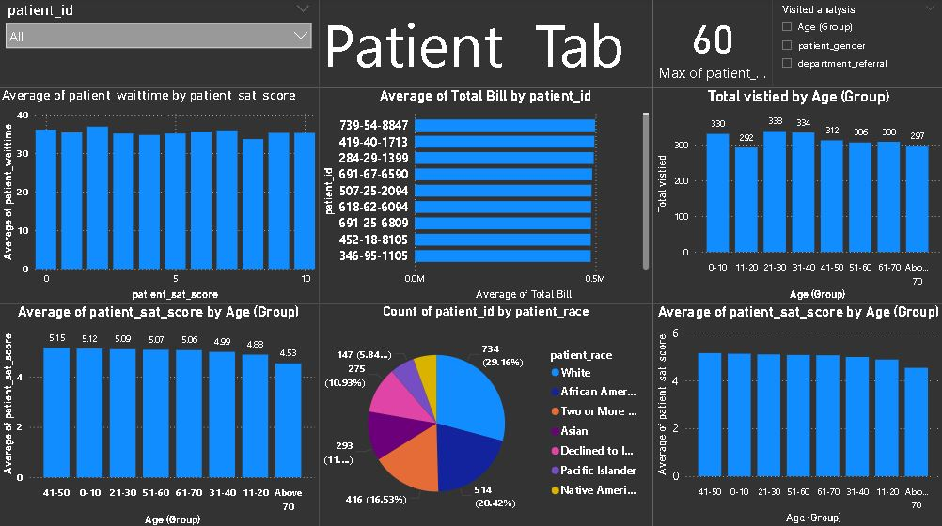
Dashboard

Slide 18


